Slide 1
Implications of Online Check-In at the Airport
Malik Tragna, Erik Bobinski, Christopher Kniss, Harrison Teele
Our GitHub Repository

Slide 2
Table of contents
01
02
Topic Overview
OMNeT++ Simulation
03
04
Analysis, Verification & Validation
Concluding Remarks

Slide 3
01
Topic Overview
The nuances of airport systems

Slide 4
Overview of System- Airport Check In
Check-in
TSA Security Check
Passengers
Enter
Passengers
Exit
Split between check in, online check-in, TSA, and TSA Precheck
Challenges:
Selecting an accurate number of servers, creating dynamic queues
Lack of data on one specific airport
Lack of data regarding inter-arrival times based on a daily schedule

Slide 5
Service Times
Check In
5-7 Minutes [1]
Online
2-4 Minutes [2]
TSA
3-4 Minutes [3]
Precheck
1-2 Minutes [4]

Slide 6
Waiting Times from Top US Airports [5]
JFK, New York
Check in: 19:54 mins
Security: 25:00 mins
O’Hare, Chicago
Check in: 17:07 mins
Security: 16:54 mins
LAX, Los Angeles
Check in: 20:08 mins
Security: 19:18 mins
Notes:
Add for average total time in system?

Slide 7

American Flight and TSA Precheck Data: 2023
49% of Americans flew at least once [6]
5% of Americans were registered with TSA Precheck [7]
“About 99% of TSA PreCheck® passengers wait less than 10 minutes” - TSA

Slide 8
02
OMNet++ Simulation
How we simulated a general airport system

Slide 9
OMNeT++ Simulation
Difficulties – Trying to model the real system
In real life…
Amount of servers change to account for increased throughput needs in rush hours
Rush hours are not deterministic and arrival rates are non-constant
How do we…
Model for deterministic rush hours with a deterministic arrival rate that could approximate that behavior?
Generate individuals in certain subgroups, this requires classification and jobs with custom individual arrival rates. (Can’t use queuing library [Took a while to know that])

Slide 10
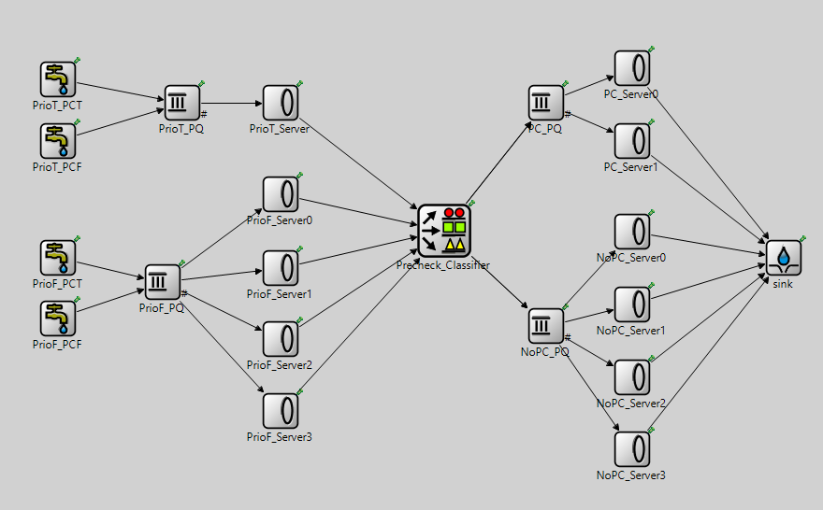
Our Simulation Architecture
NOTES
Deterministic arrival rates, but dependent with time
4 Sources emulate 1 Source
Priority Check In 1 Server
Normal Check In 4 Servers
Security, TSA Precheck 2 Servers
Security, No TSA Precheck
4 Servers
4 States (Priority, Precheck)
TT, TF, FT, FF
Security
Check In

Slide 11
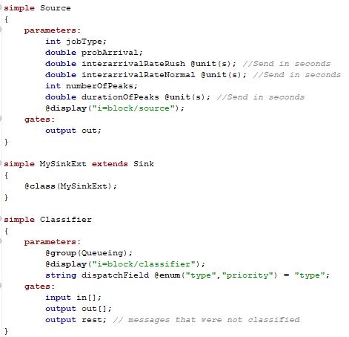
Custom Source and Sink – NED

Slide 12
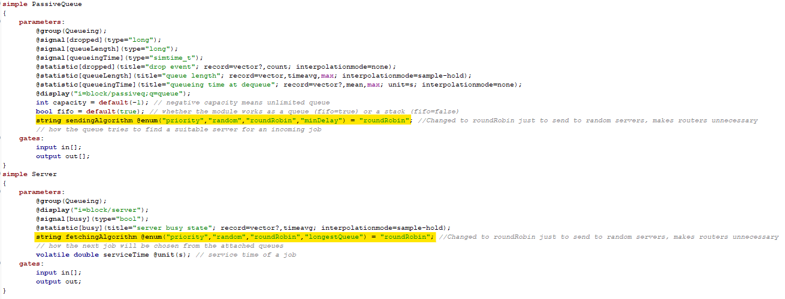
Round Robin Service – No Router

Slide 13
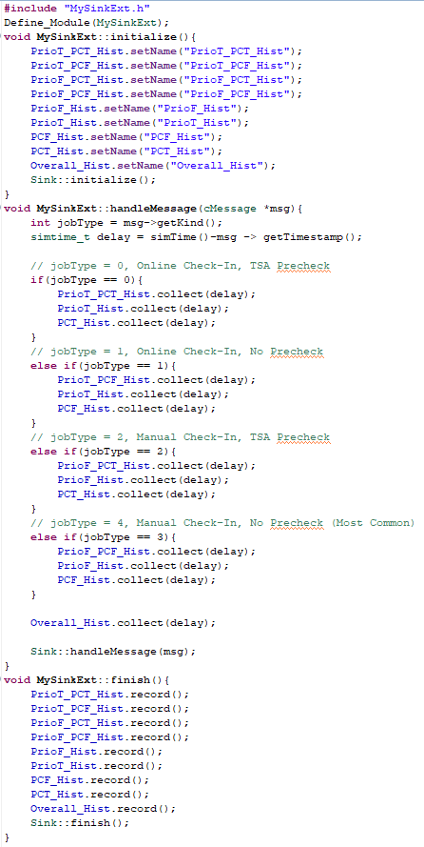
Custom Sink – MySink.cc
We used these to isolate data collection between job types (0,1,2,3) for time in system. Analyzing the histograms, they indeed took an exponential shape and reflected their subgroups properly

Slide 14
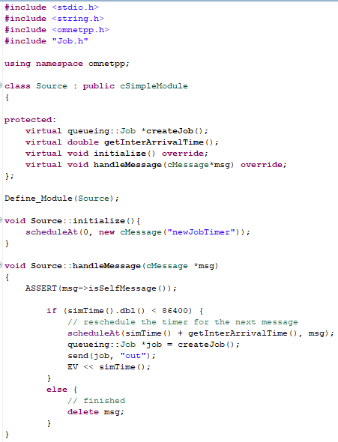
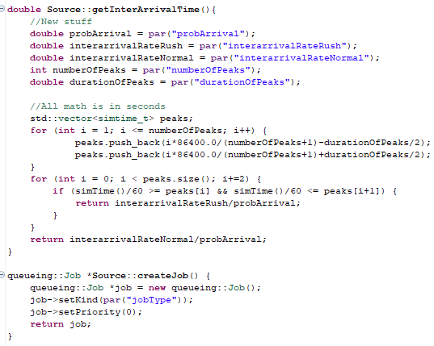
Custom Source – Variable Arrival Rates

Slide 15
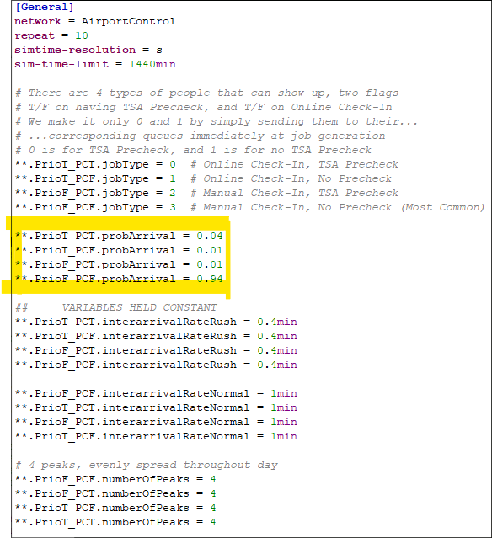
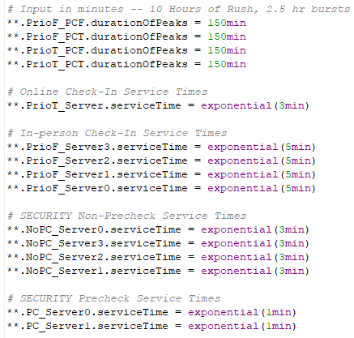
Configurations – The .INI
– Main Customization

Slide 16





Output Configurations
0%:
15%:
5%:
20%:
10%:
Constant: P(TSA Precheck) = 0.05 and P( Priority Check In | TSA Precheck) = 0.80
Video Demonstration

Slide 17
03
Analysis & Verification/Validation
Analyzing Our Simulation

Slide 18
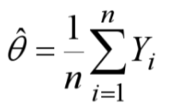
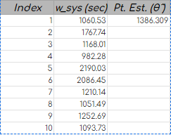
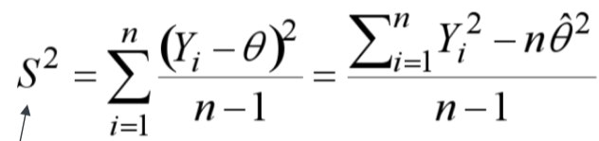



Output Analysis (20% Online Check In)
Estimation of Time in System: 23.1min
Estimation of the error in our point estimate
Avg. Standard Error - 135.84s or 2.264min
95% Confidence Interval(df=9): {1693.58, 1079.03}
Mean Time in System: 1079.03s < Θ < 1693.58s
17.98min < Θ < 28.22min

Slide 19
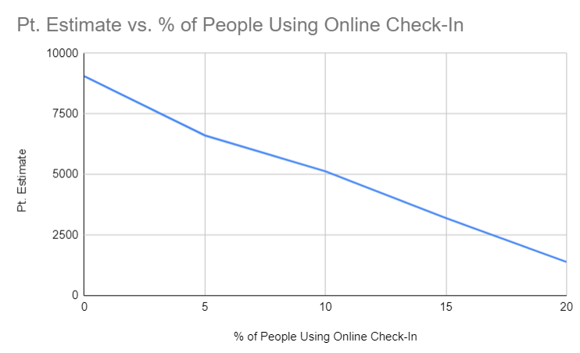
Optimal Model Alternative
Generating a graph of the point estimates vs. % of people using the online check-in option, the system is indeed valid as it displays a decreasing linear relationship between mean delay times.
With 20% of people using online check-in, delays were significantly lower than other % utilizations, thereby proving validity to our simulated model.
0% Util. Std. Error - 281.19 s
20% Util. Std. Error - 135.85s
Notes:
Anything over 20% of people using online check–in is a bit unrealistic, so we capped it at that

Slide 20
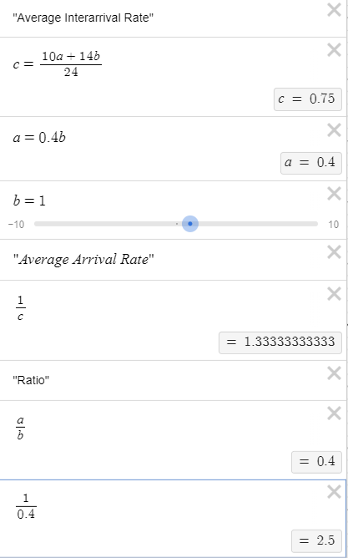
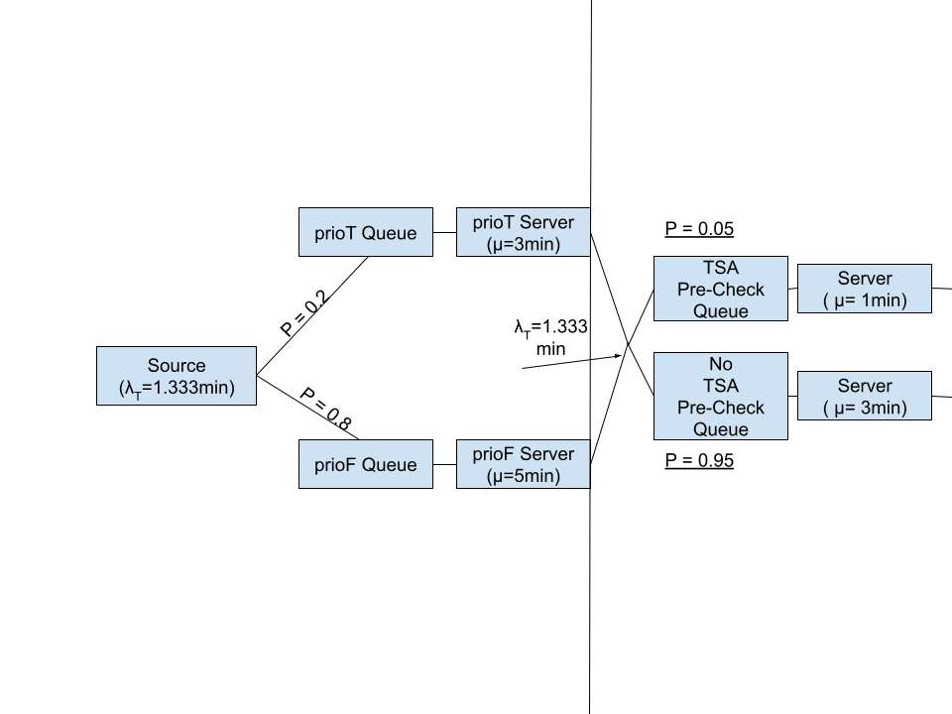
Model Verification
Check-In
Security
Link to Our Calculator
Notes:
We have to separate arrival rates that need to equal the total arrival rate, but they vary throughout the day.
For 10 hours we have rush-time arrival rate, for 14 hours we have normal arrival rate.

Slide 21
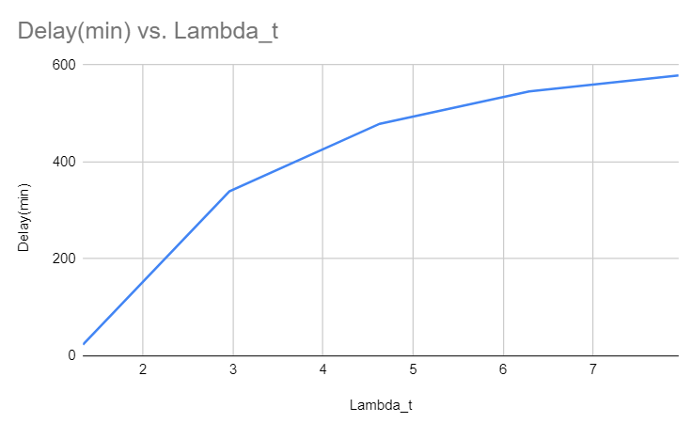
Model Validation
λ_T | Delay(s) | Delay(min)
1.333 | 1.386.309 | 23.105
2.96 | 20355.70 | 339.261
4.63 | 28721.729 | 478.695
6.29 | 32735.691 | 545.594
7.95 | 34719.962 | 578.666
In addition to the arrival rate vs. delay graph, we have similar input and output data to what we researched for airport queue systems. This includes: service times for online check-ins and standard check-ins, arrival rates for these respective demographics, and average time in system for all customers.
Arrival rate rush:normal ratio of 2.5 held through all simulations

Slide 22
04
Concluding Remarks
Results, Summary, Future Improvements

Slide 23
Concluding Remarks
Areas for improvement:
More extensive multivariate optimization
Optimize model to better describe system isomorphisms such as user transit time and overlap between channels
How this model could be useful
It is malleable to a certain degree: you can add as many amount of servers you want for each lane
Every arrival rate for each demographic is modular independent of each other
Very flexible code
Overall, higher online check in rate increases the health of the system, decreasing average wait time for every participant in the system. We have not observed a limit to this effect.

Slide 24
Contributions
Malik Tragna:
Original idea of an airport queuing system
Research type of queues, wait times, service times, probabilities
Christopher Kniss:
Created OmNet++ code
Conducted test simulations
Erik Bobinski:
Assisted with some OMNeT++ simulation
Led system validation/verification and analysis
Harrison Teele:
Performed computational analysis
Analyzed optimal performance

Slide 25
Sources
"Regular Check In Process." YouTube, uploaded by TravelTipz, 26 Sept. 2019, https://www.youtube.com/watch?v=lSemW76gf9g.
Online Check-in:
"How to Do Online Check-in." YouTube, uploaded by Nomadic Fanatic, 22 Feb. 2019, https://www.youtube.com/watch?v=_9ztDhYUuh4&t=141s.
"Online Check-in - Tips for Air Travel." YouTube, uploaded by Consumer Reports, 4 Dec. 2019, https://www.youtube.com/watch?v=z_PNAJLIn4w
TSA:
“What to Expect at TSA Checkpoints." YouTube, uploaded by DaveHax, 12 Sept. 2019, https://www.youtube.com/watch?v=t7fBqju2GJY.
"TSA Checkpoints - 10 Things You NEED to Know!" YouTube, uploaded by Kristina Braly, 17 Feb. 2020, https://www.youtube.com/watch?v=krMkC4ife5g&t=242s.
"Top 5 Tips for Getting Through TSA Quickly." YouTube, uploaded by Jen Luvs Reviews, 12 Feb. 2019, https://www.youtube.com/watch?v=bkLr1S5YRCY.TSA Precheck
TSA Precheck:
"How to Get TSA Precheck." YouTube, uploaded by Wall Street Journal, 26 Aug. 2019, https://www.youtube.com/watch?v=d72BzECeckk.
"TSA Precheck: What You Need to Know." YouTube, uploaded by Nomadic Fanatic, 17 Jan. 2020, https://www.youtube.com/watch?v=WzHk2eej1no.

Slide 26
Sources, Continued
5. Airport Wait Times:
"Airport Wait Times: Everything You Need to Know." Bounce, https://usebounce.com/blog/airport-wait-times.
6. Total US Flight Passengers:
"Air Travelers in America: Annual Survey." Airlines for America, https://www.airlines.org/dataset/air-travelers-in-america-annual-survey/.
7. TSA Precheck Enrollment:
"TSA Prepared for More Travelers at Airport Security Checkpoints Than Ever Before; Reminds Travelers to Prepare for Security before Arriving at Airport." Transportation Security Administration, 13 Nov. 2023, https://www.tsa.gov/news/press/releases/2023/11/13/tsa-prepared-more-travelers-airport-security-checkpoints-expects#:~:text=Additionally%2C%20there%20are%20now%20more,1.
Our Resources
Sheets Workbook: Link to Sheet
Our Average Interarrival Calculator: Link to Our Calculator
GitHub Repository: Project Github Repo Link

Slide 27
Thank You :)

